Slide 1

About Me
Yue Liu
E-mail: charlie.liu.offduty@gmail.com
Research interest: Responsible AI, AI Engineering, Agent Architecture, SE4AI, AI4HSE
https://scholar.google.com.au/citations?user=cG34KO4AAAAJ
https://www.linkedin.com/in/yue-liu-298646166/
Notes:
Good morning everyone
My name is Yue Liu, I am currently a researcher at CSIRO’s data61
Thanks for considering me for the role of lecturer at James cook university
I’m gonna first introduce myself to you

Slide 2
Education Background
Degree Doctor of Philosophy (2020.09 – 2024.09)
University University of New South Wales
Major Computer Science and Engineering
Supervisors Dr. Liming Zhu, Dr. Qinghua Lu, Dr. Hye-Young Paik
Research topic Software Architecture for Governance-Driven Blockchain Systems
Scholarships and awards University International Postgraduate Award
Degree Master of Engineering by Research (2017.09 – 2020.06)
University China University of Petroleum (East China)
Major Software Engineering
GPA 92/100
Degree Bachelor (2013.09 - 2017.06)
University China University of Petroleum (East China)
Major Computer Science and Technology; English (double major)
GPA 88.58/100; 88.75/100
Notes:
I finished my bachelor and master degrees back in China,
And in 2020 I started my PhD at UNSW, and I received the university international postgraduate award
my PhD research topic was software architecture for governance-driven blockchain systems

Slide 3
Publications (No. of paper: 37, citations: 1772, h-index: 18)
AI / Agent Engineering
Liu, Y., Lo, S. K., Lu, Q., Zhu, L., Zhao, D., Xu, X., ... & Whittle, J. (2025). Agent design pattern catalogue: A collection of architectural patterns for foundation model based agents. Journal of Systems and Software, 220, 112278.
Lu, Q., Zhao, D., Liu, Y., Zhang, H., Zhu, L., Xu, X., ... & Tan, T. (2024). Evaluating The Architecture Of Large Language Model-Based Agents. Submitted to Journal of Systems and Software.
Lu, Q., Zhu, L., Xu, X., Liu, Y., Xing, Z., & Whittle, J. (2024). A taxonomy of foundation model based systems through the lens of software architecture. In Proceedings of the IEEE/ACM 3rd International Conference on AI Engineering-Software Engineering for AI (pp. 1-6).
Responsible AI
Liu, Y., Lu, Q., Zhu, L., & Paik, H. Y. (2024). Decentralised governance for foundation model based ai systems: Exploring the role of blockchain in responsible AI. IEEE Software.
Lo, S. K., Liu, Y., Lu, Q., Wang, C., Xu, X., Paik, H. Y., & Zhu, L. (2022). Toward trustworthy AI: Blockchain-based architecture design for accountability and fairness of federated learning systems. IEEE Internet of Things Journal, 10(4), 3276-3284.
Lee, S. U., Perera, H., Liu, Y., Xia, B., Lu, Q., & Zhu, L. (2024). Integrating ESG and AI: A Comprehensive Responsible AI Assessment Framework. arXiv preprint arXiv:2408.00965.
Blockchain Governance
Liu, Y., Lu, Q., Yu, G., Paik, H. Y., & Zhu, L. (2022). Defining blockchain governance principles: A comprehensive framework. Information systems, 109, 102090.
Liu, Y., Lu, Q., Zhu, L., Paik, H. Y., & Staples, M. (2023). A systematic literature review on blockchain governance. Journal of Systems and Software, 197, 111576.
Notes:
For publications I have 35 papers in total and the citation is over 14 hundred.
My research interests include the AI engineering, especially for LLM-based agent systems
Responsible AI and AI safety, which aligns with the Australian AI ethics principles
And also blockchain governance and blockchain as a service

Slide 4
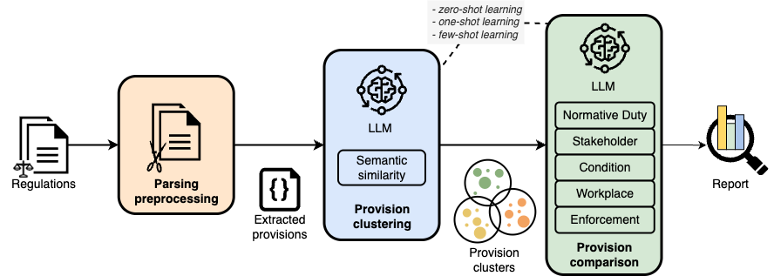
Experiences
Research Fellow
(03/2025 to present, Australian National University)
HSE Regulations analysis and comparison
Survey of AI acceptance in HSE
Project workshop preparation
Notes:
I started working as a researcher at Data61 since last year.
I served as the technical lead for the Data Bill of Materials project collaborated with IM&T.
In this project, I engaged with researchers across different business units and research projects (e.g. Environment, A&F)
to comprehend the data workflow and management requirements from other CSIRO business units.
Based on the identified painpoints and requirements, we prototyped a blockchain infrastructure and smart contracts
considering data traceability, verifiability, and reproducibility.

Slide 5
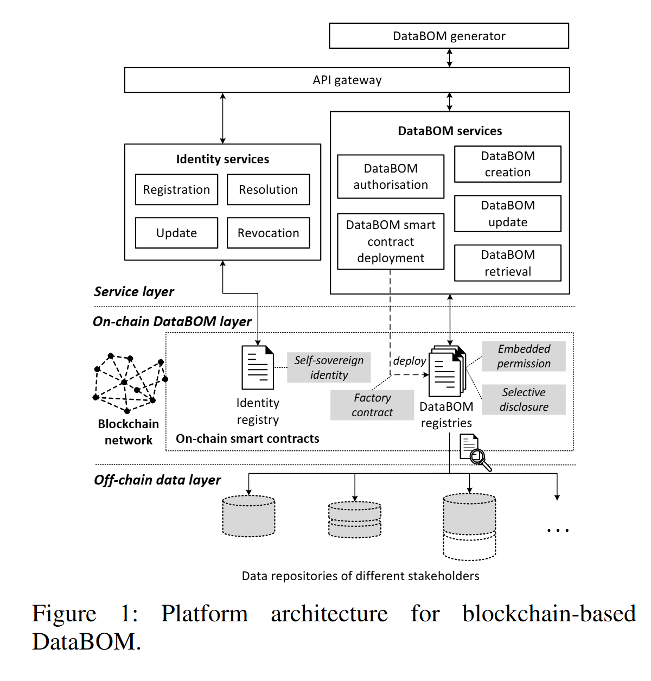
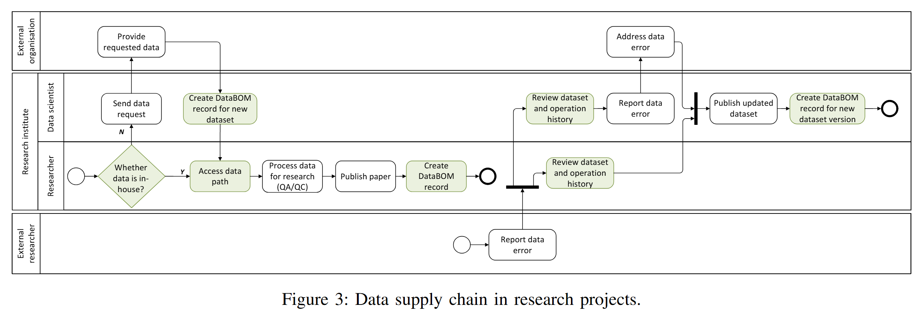
Experiences
Research Engineer
(09/2023 to 03/2025, CSIRO’s Data61)
Technical lead for the Data Bill of Materials project collaborated with CSIRO IM&T department.
Lead RAI pattern catalogue mapping to the EU AI Act, ISO 42001 standard, and Australia Voluntary AI Safety standard draft with Australia National AI Centre.
Propose an architectural pattern catalogue for foundation model-based agents.
Propose an architecture design and analyse design decision trade-offs for a tax copilot collaborating with Empathetic AI.
Receive "Early Career in Science Award" in Data61 Software & Computational Systems Biannual Awards, 2024.
Liu, Y., Zhang, D., Xia, B., Anticev, J., Adebayo, T., Xing, Z., & Machao, M. (2024, August). Blockchain-Enabled Accountability in Data Supply Chain: A Data Bill of Materials Approach. In 2024 IEEE International Conference on Blockchain (Blockchain) (pp. 557-562). IEEE.
Notes:
I started working as a researcher at Data61 since last year.
I served as the technical lead for the Data Bill of Materials project collaborated with IM&T.
In this project, I engaged with researchers across different business units and research projects (e.g. Environment, A&F)
to comprehend the data workflow and management requirements from other CSIRO business units.
Based on the identified painpoints and requirements, we prototyped a blockchain infrastructure and smart contracts
considering data traceability, verifiability, and reproducibility.

Slide 6
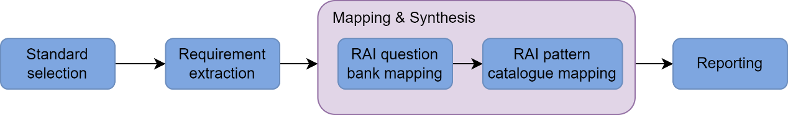
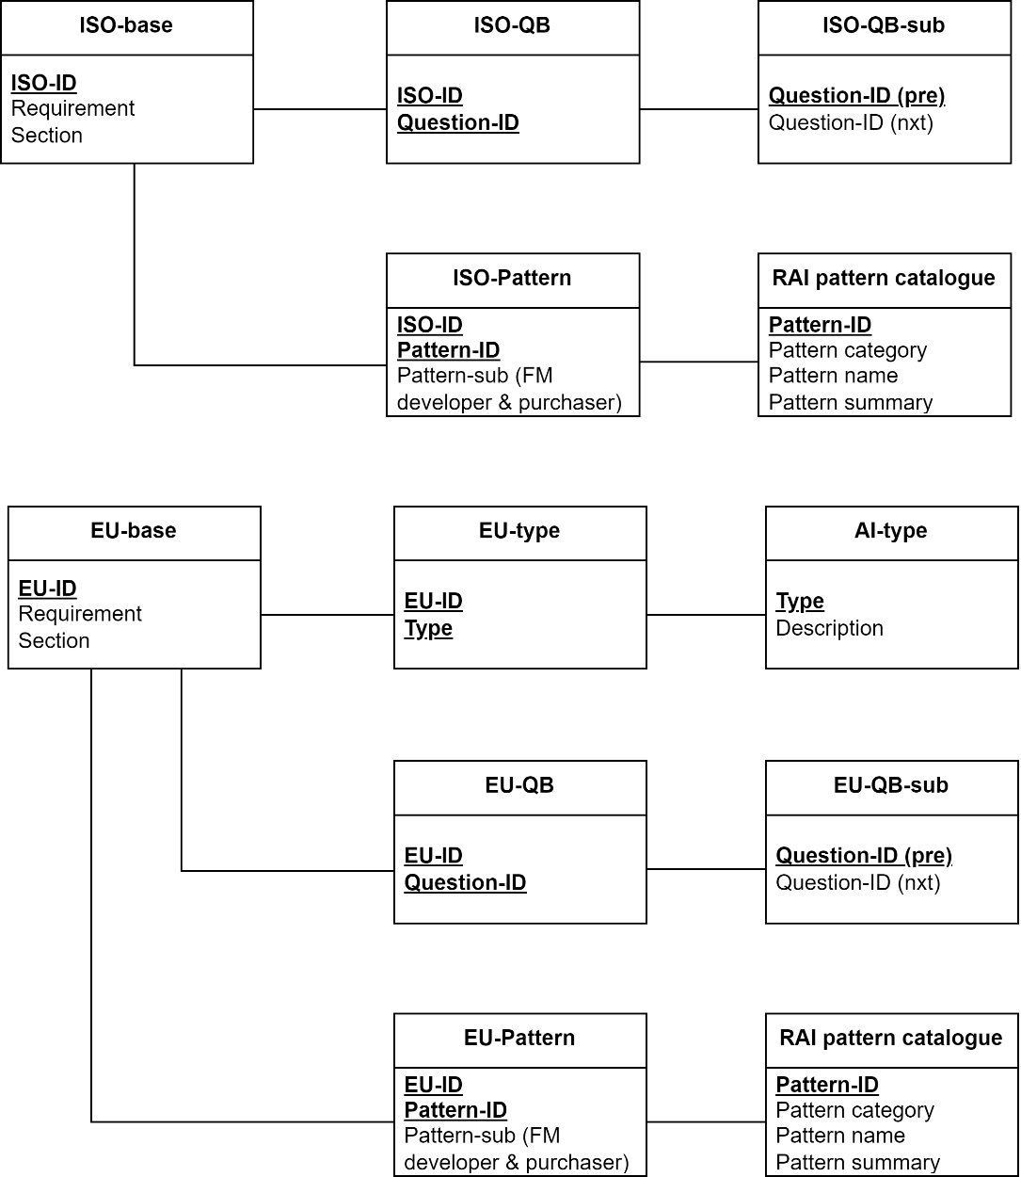
Experiences
Research Engineer
(09/2023 to 03/2025, CSIRO’s Data61)
Technical lead for the Data Bill of Materials project collaborated with CSIRO IM&T department.
Lead RAI pattern catalogue mapping to the EU AI Act, ISO 42001 standard, and Australia Voluntary AI Safety standard draft with Australia National AI Centre.
Propose an architectural pattern catalogue for foundation model-based agents.
Propose an architecture design and analyse design decision trade-offs for a tax copilot collaborating with Empathetic AI.
Receive "Early Career in Science Award" in Data61 Software & Computational Systems Biannual Awards, 2024.
Figure 1 Methodology.
Figure 2 Mapping schema.
Notes:
I contributed to the national AI center mega project by
coordinating the research team of RAI digital platform;
conducted RAI pattern catalogue mapping to different standards and regulations, including EU AI Act, ISO 42001 standard, and Australia Voluntary AI Safety standard, and;
engaged with researchers from the Gradient Institute for further content tagging of RAI practices.
screening EU AI Act and ISO/IEC 42001:2023 Standard, extracting and enumerating the included requirements.
conducted mapping between the extracted requirements to particular RAI patterns, considering the question bank mapping in the previous step.
The mapping outcome consists of a series of spreadsheets. Figure 2 visualises the mapping relationship in a high-level manner

Slide 7
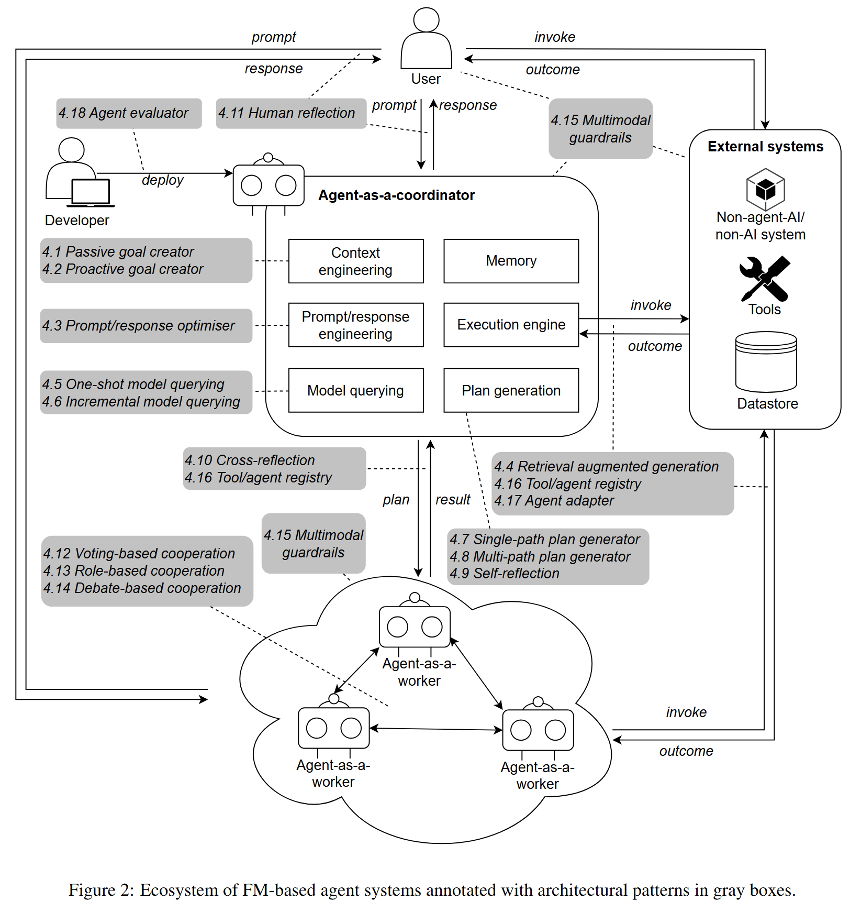
Experiences
Research Engineer
(09/2023 to 03/2025, CSIRO’s Data61)
Technical lead for the Data Bill of Materials project collaborated with CSIRO IM&T department.
Lead RAI pattern catalogue mapping to the EU AI Act, ISO 42001 standard, and Australia Voluntary AI Safety standard draft with Australia National AI Centre.
Propose an architectural pattern catalogue for foundation model-based agents.
Propose an architecture design and analyse design decision trade-offs for a tax copilot collaborating with Empathetic AI.
Receive "Early Career in Science Award" in Data61 Software & Computational Systems Biannual Awards, 2024.
Liu, Y., Lo, S. K., Lu, Q., Zhu, L., Zhao, D., Xu, X., ... & Whittle, J. (2025). Agent design pattern catalogue: A collection of architectural patterns for foundation model based agents. Journal of Systems and Software, 220, 112278.
Notes:
Many researchers and practitioners are investigating LLM-based agents and the related design patterns
including Andrew Ng
We provide a collection of architectural patterns, which can offer a design solution pool for practitioners to select from for real-world agent implementations.
And the preprint received comments and further discussions.
We analyse how the patterns can help address issues such as hallucinations, explainability, etc.
We demonstrate FM-based agent ecosystem with architectural pattern annotations, serving as a guide for the design and development of FM-based agents.
We conduct curated analysis of each included pattern regarding the application context, addressed issues, consequent benefits and trade-offs on software quality attributes, real-world known uses, and the relationship with other patterns.

Slide 8
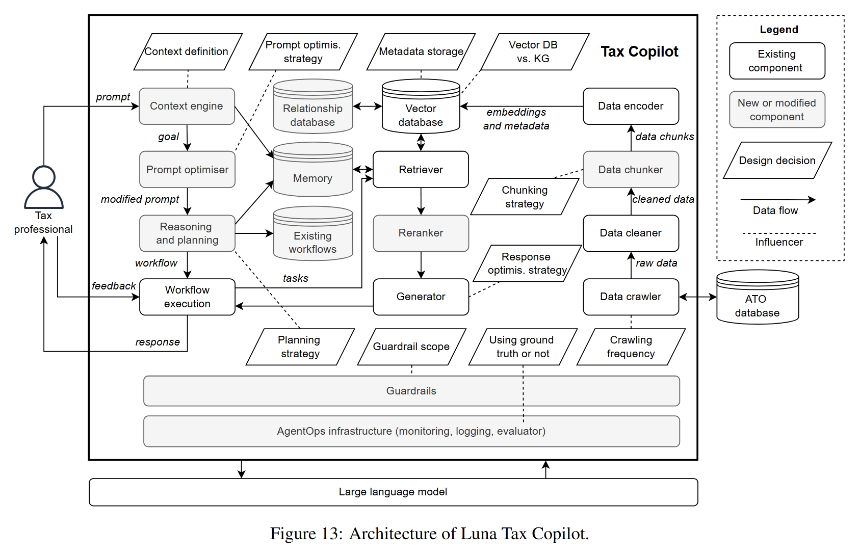
Experiences
Research Engineer
(09/2023 to 03/2025, CSIRO’s Data61)
Technical lead for the Data Bill of Materials project collaborated with CSIRO IM&T department.
Lead RAI pattern catalogue mapping to the EU AI Act, ISO 42001 standard, and Australia Voluntary AI Safety standard draft with Australia National AI Centre.
Propose an architectural pattern catalogue for foundation model-based agents.
Propose an architecture design and analyse design decision trade-offs for a tax copilot collaborating with Empathetic AI.
Receive "Early Career in Science Award" in Data61 Software & Computational Systems Biannual Awards, 2024.
Lu, Q., Zhao, D., Liu, Y., Zhang, H., Zhu, L., Xu, X., ... & Tan, T. (2024). Evaluating The Architecture Of Large Language Model-Based Agents. Submitted to Journal of Systems and Software.
Notes:
LLM-based tax copilot
We discussed with the Empathetic AI project team and gained clear understanding of the primary goal of the Luna tax copilot design the architecture from data collection, chunking, to LLM-based agent reasoning and rag strategies.
RAG strategy evaluation

Slide 9
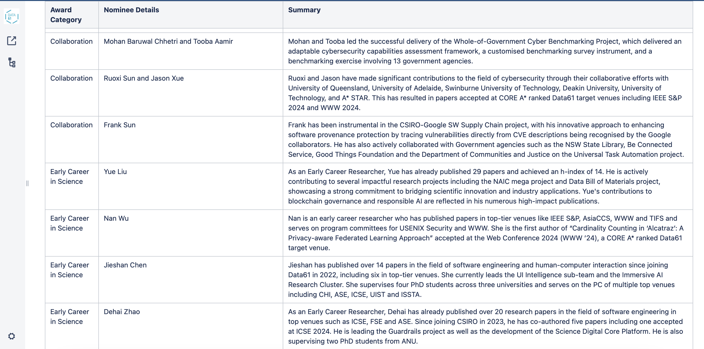
Experiences
Research Engineer
(09/2023 to 03/2025, CSIRO’s Data61)
Technical lead for the Data Bill of Materials project collaborated with CSIRO IM&T department.
Lead RAI pattern catalogue mapping to the EU AI Act, ISO 42001 standard, and Australia Voluntary AI Safety standard draft with Australia National AI Centre.
Propose an architectural pattern catalogue for foundation model-based agents.
Propose an architecture design and analyse design decision trade-offs for a tax copilot collaborating with Empathetic AI.
Receive "Early Career in Science Award" in Data61 Software & Computational Systems Biannual Awards, 2024.

Slide 10
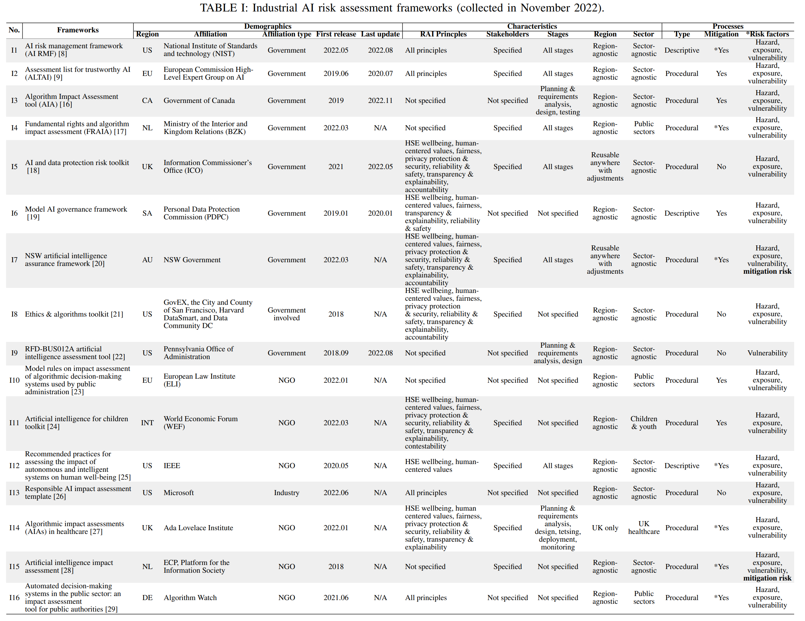
Experiences
Research Technician
(07/2022 to 09/2023, CSIRO’s Data61)
Conduct multivolcal literature review for risk assessment for Responsible AI.
Develop a question bank which can facilitate effective AI risk assessment.
Refine metrics for AI risk assessment.
Xia, B., Lu, Q., Perera, H., Zhu, L., Xing, Z., Liu, Y., & Whittle, J. (2023, May). Towards Concrete and Connected AI Risk Assessment (C 2 AIRA): A Systematic Mapping Study. In 2023 IEEE/ACM 2nd International Conference on AI Engineering–Software Engineering for AI (CAIN) (pp. 104-116). IEEE.
Notes:
choose the most appropriate one for their context. Moreover, it is unclear how effective these frameworks are at assessing and mitigating AI risks.
We present a comprehensive qualitative and quantitative analysis and synthesis of 16 state-of-practice AI risk assessment frameworks selected from the grey literature.
Characteristics
Stakeholders
Assessment practices
Mapped to the Australian AI ethics principles

Slide 11
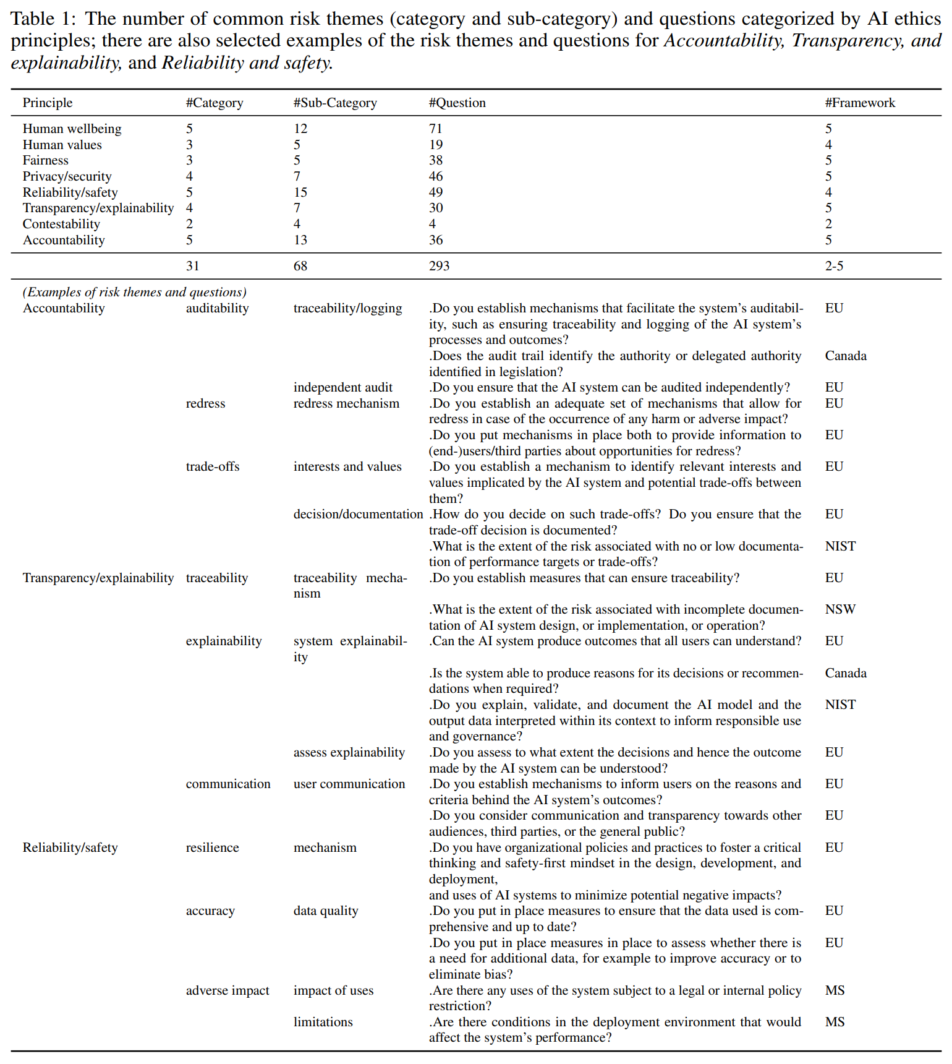
Experiences
Research Technician
(07/2022 to 09/2023, CSIRO’s Data61)
Conduct multivolcal literature review for risk assessment for Responsible AI.
Develop a question bank which can facilitate effective AI risk assessment.
Refine metrics for AI risk assessment.
Lee, S. U., Perera, H., Xia, B., Liu, Y., Lu, Q., Zhu, L., ... & Whittle, J. (2023). Qb4aira: A question bank for ai risk assessment. arXiv preprint arXiv:2305.09300.
Notes:
Based on the literature review, we developed a question bank based on (i) global recognition, (ii) inclusion of risk assessment questions, and (iii) representation of different regions and industry leaders of the included frameworks.
The question bank consists of 293 questions, which are mapped to Australian AI ethics principles and common risk themes
Here are some example questions

Slide 12
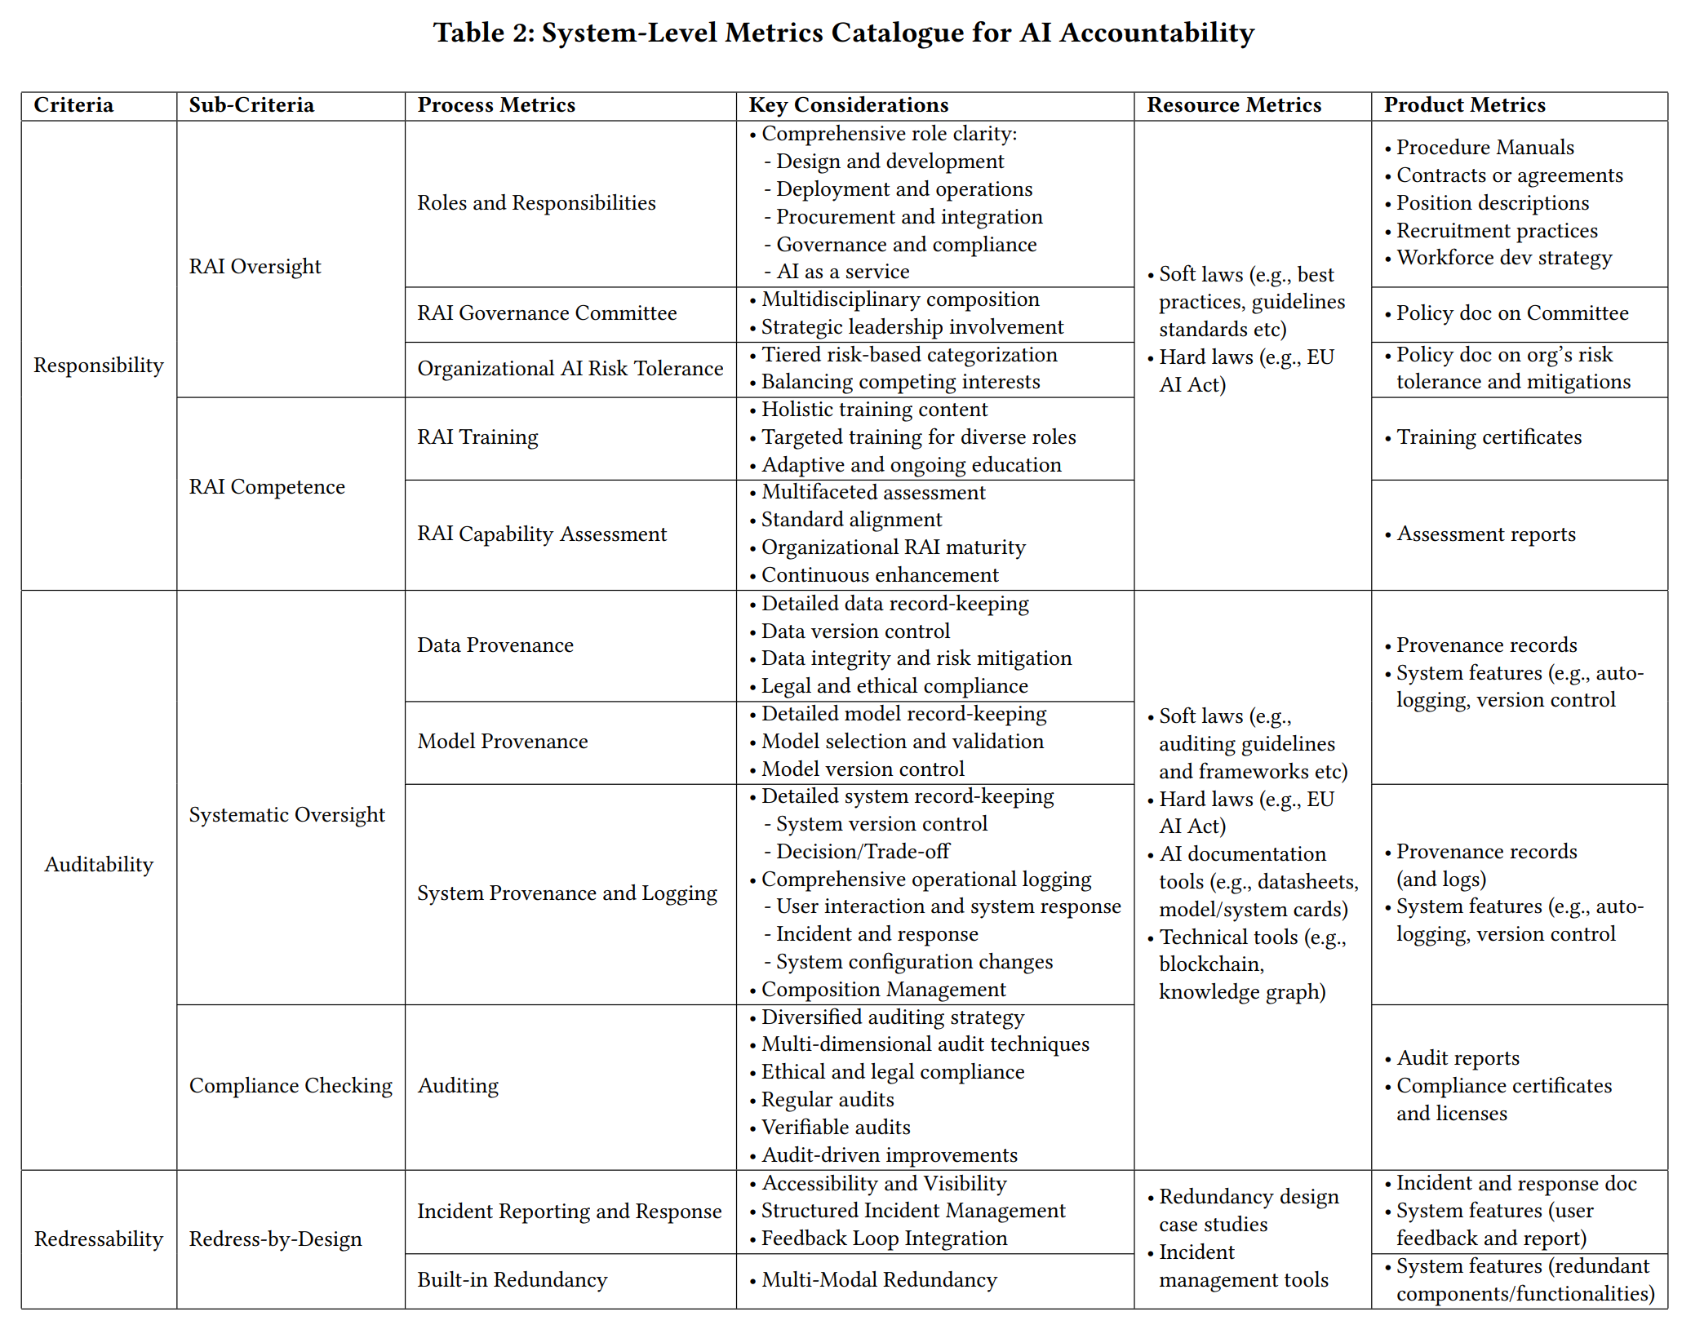
Experiences
Research Technician
(07/2022 to 09/2023, CSIRO’s Data61)
Conduct multivolcal literature review for risk assessment for Responsible AI.
Develop a question bank which can facilitate effective AI risk assessment.
Refine metrics for AI risk assessment.
Xia, B., Lu, Q., Zhu, L., Lee, S. U., Liu, Y., & Xing, Z. (2024, April). Towards a Responsible AI Metrics Catalogue: A Collection of Metrics for AI Accountability. In Proceedings of the IEEE/ACM 3rd International Conference on AI Engineering-Software Engineering for AI (pp. 100-111).
Notes:
Work on the metrics which aim to quantify responsible AI
process metrics that underpin procedural integrity,
resource metrics that provide necessary tools and frameworks,
and product metrics that reflect the outputs of AI systems.
thematic coding

Slide 13
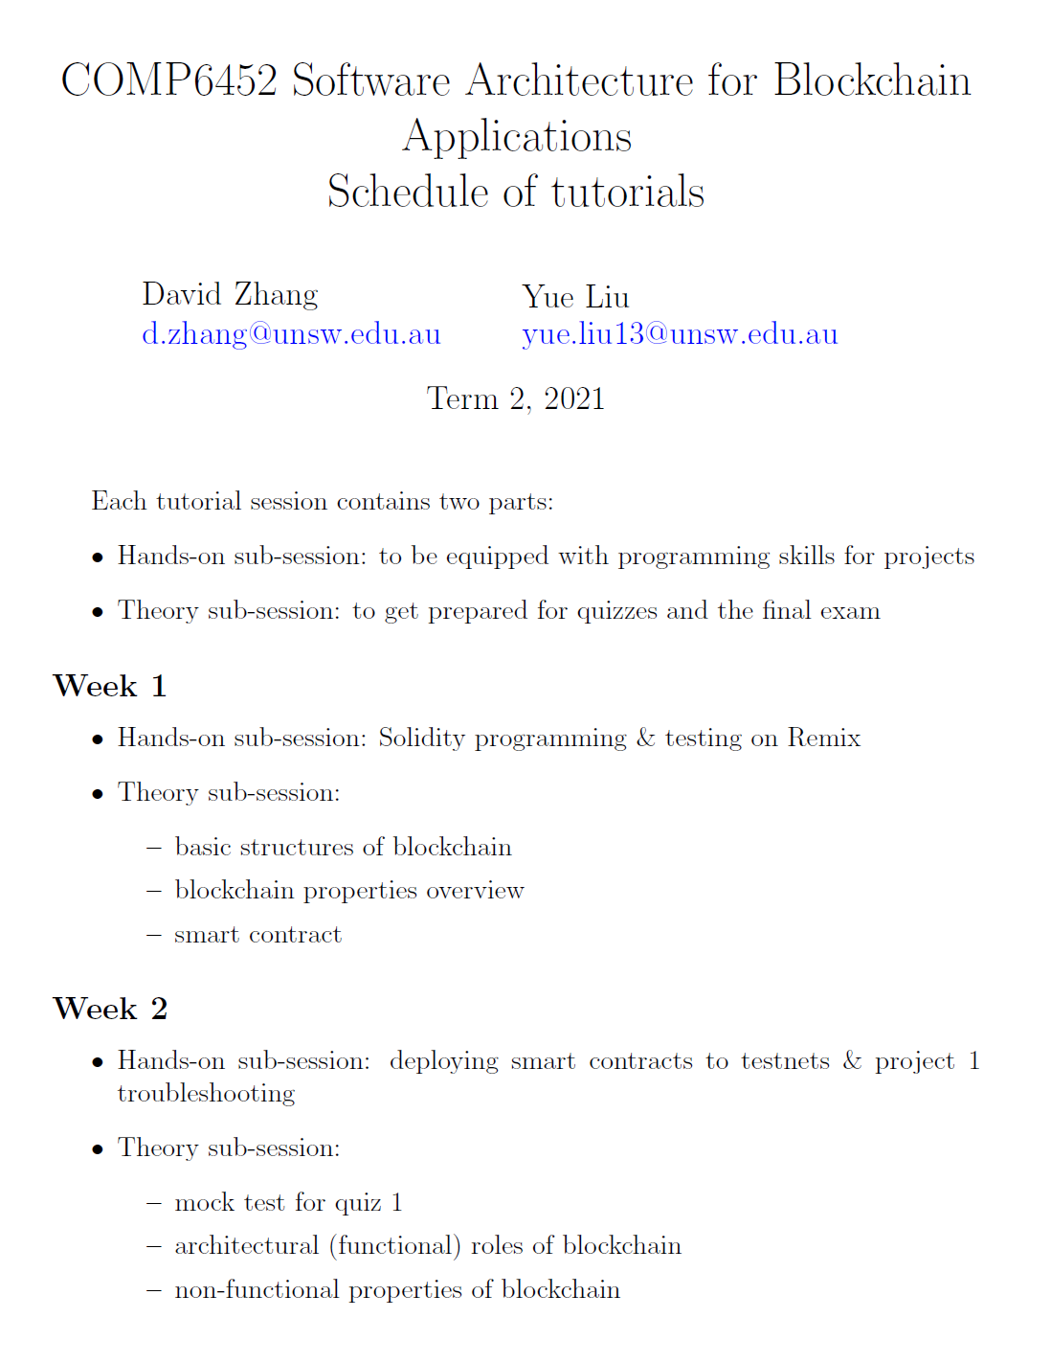
Experiences
Teaching Assistant
(05/2021 to 08/2021, University of New South Wales)
Worked as a tutor for Blockchain Software Architecture course with ~100 students at undergrad/postgrad levels.
Taught weekly 2-hour tutorials.
Mentored 20 groups of students on blockchain projects.
Notes:
Remix online IDE
Install private blockchain networks and deploy smart contracts
Help students prepare the quiz and present some academic papers about blockchain system architecture for their group work projects

Slide 14
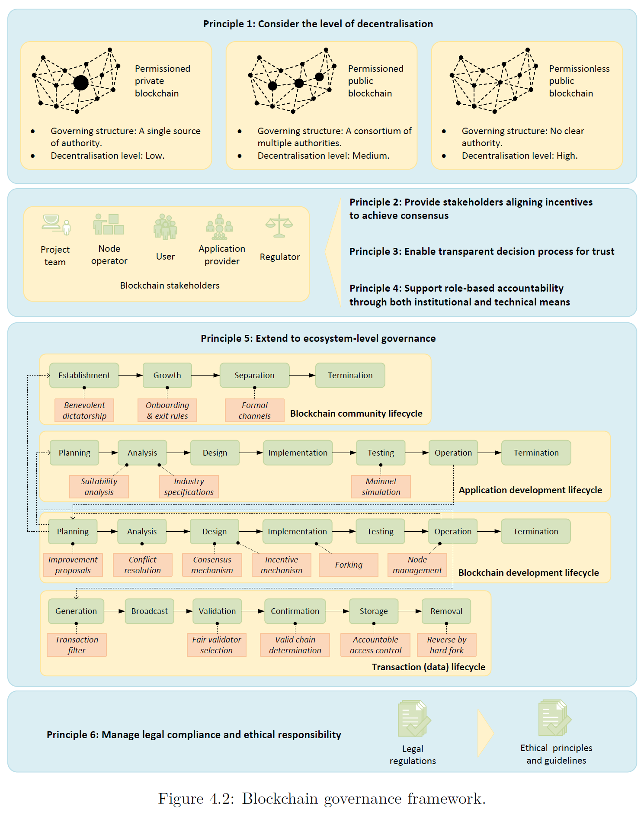
Experiences
PhD Research Project:
Software Architecture for Governance-Driven Blockchain Systems
(09/2020 to 09/2024)
Establish a governance framework for blockchain systems.
Propose a pattern language for blockchain governance.
Design a pattern-oriented architecture for governance-driven blockchain systems.
Liu, Y., Lu, Q., Yu, G., Paik, H. Y., & Zhu, L. (2022). Defining blockchain governance principles: A comprehensive framework. Information systems, 109, 102090.
Notes:
blockchain governance framework consisting of six high-level principles
for blockchain governance.
the framework
1) elucidates a systematic mapping of blockchain stakeholders and their respective decision rights, accountability,
and incentives,
2) extends governance to the blockchain ecosystem with a set of
identified governance mechanisms,
and 3) emphasises legal compliance and ethical
responsibilities in blockchain governance.

Slide 15
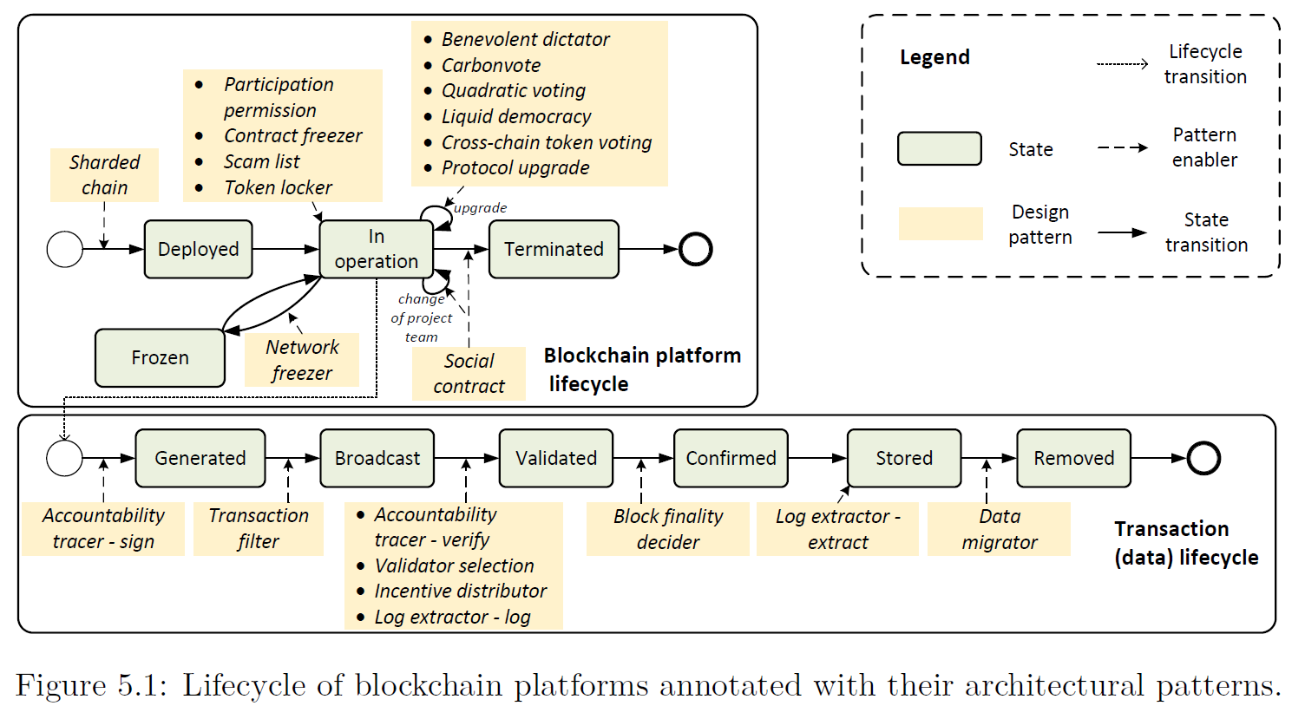
Experiences
PhD Research Project:
Software Architecture for Governance-Driven Blockchain Systems
(09/2020 to 09/2024)
Establish a governance framework for blockchain systems.
Propose a pattern language for blockchain governance.
Design a pattern-oriented architecture for governance-driven blockchain systems.
Liu, Y., Lu, Q., Yu, G., Paik, H. Y., Perera, H., & Zhu, L. (2022, July). A pattern language for blockchain governance. In Proceedings of the 27th European Conference on Pattern Languages of Programs (pp. 1-16).
Notes:
A pattern language consisting of 20 architectural patterns for realising the governance
of blockchain. Each pattern is associated with the stage or stage transition
of blockchain platform lifecycle or on-chain transaction lifecycle.

Slide 16
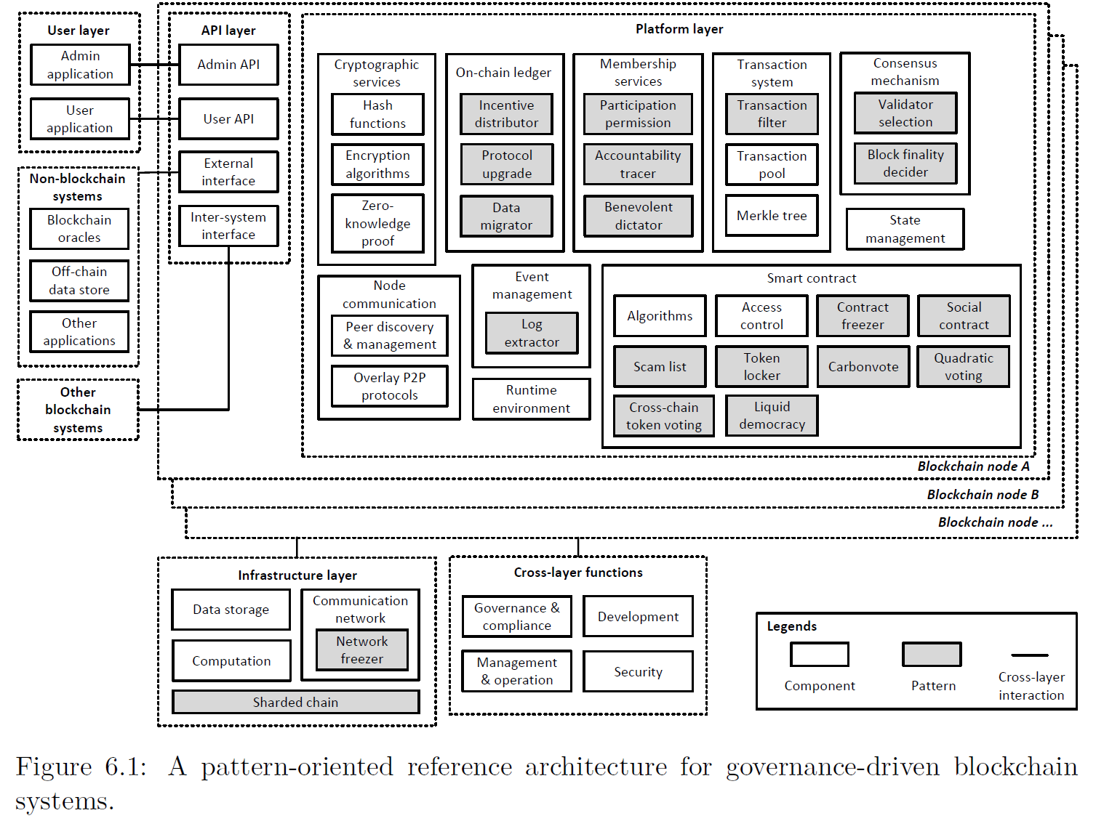
Experiences
PhD Research Project:
Software Architecture for Governance-Driven Blockchain Systems
(09/2020 to 09/2024)
Establish a governance framework for blockchain systems.
Propose a pattern language for blockchain governance.
Design a pattern-oriented architecture for governance-driven blockchain systems.
Liu, Y., Lu, Q., Yu, G., Paik, H. Y., & Zhu, L. (2023, March). A pattern-oriented reference architecture for governance-driven blockchain systems. In 2023 IEEE 20th International Conference on Software Architecture (ICSA) (pp. 23-34). IEEE.
Notes:
We extend a widely-accepted blockchain reference architecture with additional components,
to provide guidance for the design and development of governance-driven
blockchain systems. The identified architectural patterns are associated with different
components in the extended reference architecture, to address the recurring
governance-related issues in blockchain systems.

Slide 17
Experiences
Professional Services:
Conference Committees
ICSE 2025, 3rd International Workshop on Responsible AI Engineering, PC member
ICSA 2025, 4th International Workshop on Software Architecture and Machine Learning, PC member
IEEE S&P 2025, Human-Machine Intelligence for Security Analytics, PC member
IEEE ISPA 2024, Main track, PC member
IEEE Blockchain 2024, Main track, PC member
ICSE 2024, 2rd International Workshop on Responsible AI Engineering, PC member
IEEE Blockchain 2023, Main track, PC member
Invited Reviewer
ACM Computing Surveys
Journal of Systems & Software
ACM Transactions on Sensor Networks
IEEE Transactions on Intelligent Transportation Systems
IEEE Transactions on Neural Networks and Learning Systems
IEEE Transactions on Computational Social Systems
IEEE Transactions on Intelligent Vehicles
IEEE Software
IT Professional
Notes:
We extend a widely-accepted blockchain reference architecture with additional components,
to provide guidance for the design and development of governance-driven
blockchain systems. The identified architectural patterns are associated with different
components in the extended reference architecture, to address the recurring
governance-related issues in blockchain systems.

Slide 18
Thank You

